Slide 1
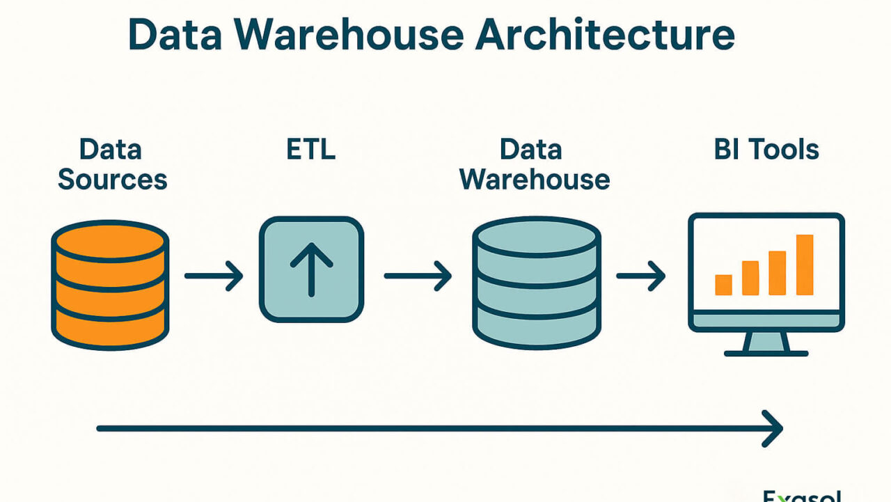
Technical Documentation
Insurance Data
Warehouse ETL
Pipeline
Centralizing Claims Data for Advanced Analytics & Business Intelligence
Star Schema Architecture
Python ETL Pipeline
BI-Ready Analytics

Slide 2
Navigation
Table of Contents
01
Project Overview & Purpose
02
System Architecture
Goals and objectives of the data warehouse initiative
Star schema design and dimensional modeling approach
03
Data Model Design
04
ETL Process Flow
Dimension tables and fact table structure
Extract, Transform, and Load operations
05
Business Intelligence
06
Technical Specifications
Pre-built KPI views and analytics capabilities
Technology stack and performance optimizations
07
Business Metrics & KPIs
08
Business Value & Use Cases
Financial, operational, and customer metrics
Real-world applications and ROI

Slide 3
01
Project Overview & Purpose
Comprehensive Insurance Data Warehouse ETL Pipeline
Centralize Data
Aggregate insurance claims data from disparate sources into a unified repository
Primary Goal
Enable Analytics
Support advanced analytics and BI reporting for data-driven decisions
Centralize and analyze insurance claims data from multiple sources, transforming raw operational data into a structured dimensional model suitable for business intelligence and analytics.
Detect Fraud
End-to-End ETL Solution
Identify suspicious patterns and potential fraudulent claims automatically
Monitor KPIs
Provide real-time metrics for performance monitoring and optimization

Slide 4
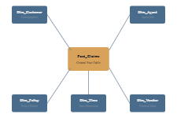
02
System Architecture
Star Schema Dimensional Modeling Approach
Data Warehouse Schema
Star Schema Benefits
Query Performance: Optimized for analytical queries with fewer joins
Simplicity: Easy to understand and maintain dimensional structure
Scalability: Efficient handling of large data volumes
Architecture Components
1 Fact Table
5 Dimension Tables
Foreign Key Links
BI Views Layer
Design Principle
The star schema centralizes measurable business events in the fact table while surrounding dimensions provide rich descriptive context for analysis.

Slide 5
03
Data Model: Dimension Tables
Descriptive Context for Business Analysis
Dim_Customer
Dim_Agent
Customer demographics and attributes for segmentation analysis
Insurance agent information for performance tracking
Age
Gender
Risk Profile
Location
Tenure
Agent Name
Joining Date
Tenure
Location
Dim_Vendor
Dim_Policy
External vendor and service provider data
Insurance policy details and coverage information
Vendor Name
Location
Service Type
Policy Number
Insurance Type
Premium
Effective Date
Dim_Time
Date dimension enabling time-based analysis and trend identification
Year
Quarter
Month
Day
Weekend Flag
Fiscal Period

Slide 6
03
Data Model: Fact Table & Measures
Central Transactional Repository
Fact_Claims
Foreign Key Relationships
Central Fact Table
FK
Customer_Key → Dim_Customer
The core transactional table containing measurable business events. Each record represents a single insurance claim with quantitative metrics and foreign key references to all dimension tables.
FK
Agent_Key → Dim_Agent
FK
Vendor_Key → Dim_Vendor
Premium Amount
FK
Policy_Key → Dim_Policy
Insurance premium paid by customer
FK
Time_Key → Dim_Time
Claim Amount
Total amount claimed by customer
Aggregation Support
Settlement Days
The fact table design enables efficient aggregation across multiple dimensions:
Days between loss date and report date
SUM, AVG, COUNT operations on measures
Fraud Flags
GROUP BY any dimension combination
Indicators of potentially fraudulent claims
Time-series analysis and trending

Slide 7
04
ETL Process: Extract & Transform
Data Ingestion and Transformation Pipeline
01
EXTRACT
02
TRANSFORM
Reads data from three CSV source files with UTF-8 encoding and validates data integrity on input.
Data Cleaning
• Missing value handling with strategic imputation
insurance_data.csv
• Data type conversion for numeric, date, categorical fields
Claims and customer data
• Text normalization and standardization
• Date calculations for settlement days and tenure
employee_data.csv
Derived Metrics
Agent information
• Age Groups: Categorized age brackets (18-25, 26-35, etc.)
• Tenure Groups: Customer loyalty categories
vendor_data.csv
• Settlement Days: Days between loss and report
Vendor information
• High Claim Flag: Claims > 50x premium
Fraud Detection Logic
1
Unusual Claim Size
2
Suspicious Timing
3
Missing Documentation
Claim > 50× premium amount
Late night claims > $5,000 (23:00-04:00)
Major loss without police reports

Slide 8
04
ETL Process: Load Strategy
Batch Processing and Data Integrity
03
LOAD
Loading Order
Strategic batch processing with optimized batch sizes to prevent memory overload while maintaining data integrity through proper loading order.
Critical sequence to maintain referential integrity:
1
Load all dimension tables first
Customer Dimension
500 records
2
Load fact table with foreign key references
3
Create business views for analytics
Agent Dimension
500 records
Vendor Dimension
500 records
Performance Optimizations
Policy Dimension
500 records
Batch Processing
Vectorized Operations
Prevents memory overload
Fast pandas transformations
Indexed Foreign Keys
Connection Pooling
Time Dimension
1,000 days
Optimized query performance
Efficient DB connections
Transaction Management
Fact Table
1,000 records
Data integrity with commits/rollbacks

Slide 9
05
Business Intelligence Capabilities
Pre-built KPI Views for Analytics
vw_monthly_kpis
vw_agent_performance
Monthly Performance Dashboard
Agent Efficiency Analysis
Total Claims & Claim Amount
Claims Handled per Agent
Premium Amount & Loss Ratio
Average Settlement Days
Fraud Rate Tracking
Fraud Cases by Agent
Use Case: Monthly business review and trend analysis
Use Case: Performance evaluation and training needs
vw_customer_segments
vw_business_summary
Customer Analytics
Executive Dashboard
Claims by Age Group
Overall Loss Ratio
Risk Segment Analysis
Total Claims & Premium
Social Class Distribution
Fraud Rate & Trends
Use Case: Targeted marketing and risk assessment
Use Case: Executive reporting and strategic planning

Slide 10
06
Technical Specifications
Technology Stack & Performance Optimizations
Key Libraries
Technology Stack
pandas
numpy
datetime
MySQL
Data manipulation
Numerical ops
Date handling
Relational Database
Python
ETL Engine (Pandas, NumPy)
Performance Optimizations
Batch Processing
mysql-connector
Prevents memory overload with controlled batch sizes
Database Connectivity
Vectorized Operations
Fast pandas transformations for efficiency
Power BI
Indexed Foreign Keys
Business Intelligence Layer
Optimized query performance for joins
Connection Pooling
CSV Files
Efficient database connection management
Data Sources
Transaction Management
Data integrity with commits and rollbacks

Slide 11
07
Business Metrics & KPIs
Comprehensive Performance Measurement Framework
Financial Metrics
Operational Metrics
Customer Metrics
Loss Ratio
Avg Settlement Days
Customer Tenure
(Claim Amount / Premium) × 100
AVG(Report Date - Loss Date)
Purpose: Loyalty analysis and retention strategies
Purpose: Profitability indicator
Purpose: Process efficiency
Avg Claim Cost
Claims Volume
Claims by Demographics
Total Claims / Number of Claims
COUNT(Claims)
Purpose: Risk profiling by age, gender, location
Purpose: Risk assessment
Purpose: Workload monitoring
Premium Earned
Fraud Rate
Customer Segmentation
Sum of all premiums
(Fraud Cases / Total) × 100
Purpose: Targeted marketing and pricing
Purpose: Revenue tracking
Purpose: Risk management

Slide 12
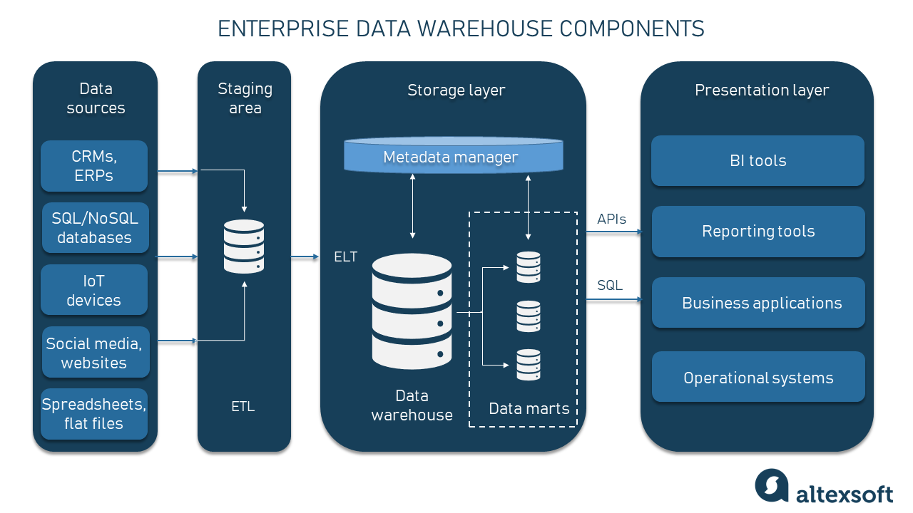
Ready for Production
Building Data-Driven
Insurance Operations
This Insurance Data Warehouse provides a robust foundation for real-time analytics, fraud prevention, performance monitoring, and strategic decision-making.
Real-Time Analytics
Fraud Prevention
Performance Monitoring
Live KPI monitoring and trending
Automated detection and alerts
Agent and operational tracking
Scalable, maintainable, and ready for BI tool integration

